Slide 1
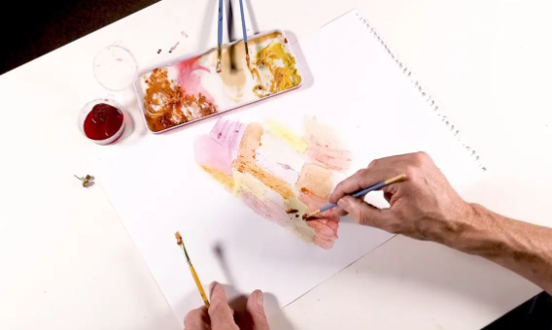
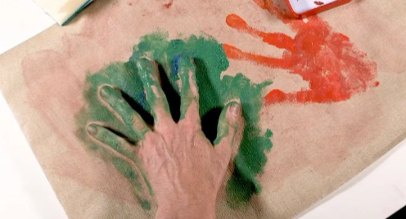
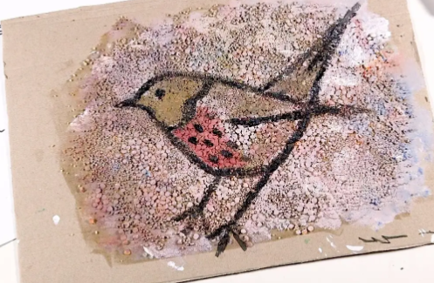
Art: Drawing: Flowers Composition
Key Vocabulary:
Proportion | The relationship between sizes of different parts of a composition
Natural Materials | Materials that occur in nature, such as berries, leaves and spices.
Enlarge | To make something bigger
Positive Space | The main focus of a piece of art, also known as the subject.
Negative Space | The space around the main focus of a piece of art, also known as the background.
Sticky Knowledge Facts:
When sketching, we should lightly map out the sketch to get the correct proportions, before adding a darker outline, then finally adding detail. When enlarging drawings, you should start with the 2D shapes to check the relative size of each part of their animal. In the past, people used natural materials such as leaves, berries and spices, to create different paint colours. Different textures and effects can be created by using different parts of the brush, or by using different sized brushes. Positive space in art is the main subject of interest, while negative space is the background or empty space around this.

Slide 2
When sketching, we should lightly map out the sketch to get the correct proportions, before adding a darker outline, then finally adding detail.

Slide 3
When enlarging drawings, you start with the 2D shapes to check the relative size of each part of their animal.

Slide 4
In the past, people used natural materials such as leaves, berries and spices, to create different paint colours.

Slide 5
Different textures and effects can be created by using different parts of the brush, or by using different sized brushes.

Slide 6
Positive space in art is the main subject of interest, while negative space is the background or empty space around this.

