Slide 1
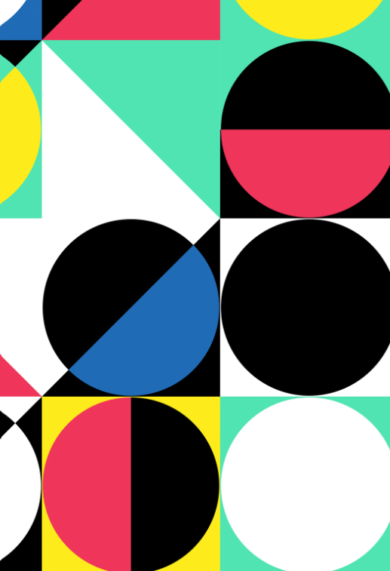
Art: Structures and 3D: Abstract Shapes and Space
Key Vocabulary:
Negative space | This is the empty space surrounding and between the subjects of an image which can be used to emphasis the subject, create interesting shapes and add depth.
Positive space | This refers to the areas of interest or the subject matter in the composition
Abstract | Work that doesn’t represent reality realistically. Instead it focuses on shapes, colours, form and gestural marks to convey ideas and emotions rather than a specific object.
Found objects | Everyday objects or natural objects, often repurposed or altered, to create art.
Sculptor | A visual artist who designs and creates three-dimensional art.
Sticky Knowledge Facts:
Sculpture is an ancient art form. Sculptures have been created for thousands of years, with some of the earliest known sculptures dating back to ancient civilizations like the Greeks. Sculptures can be made from many different materials. Artists use materials like stone, clay, wood, metal and even glass or fabric to create sculptures. Sculpture can express emotions. Artists use sculpture to express feelings, ideas or stories. Sculptures can be 3D or relief. Some sculptures are fully 3D but others are relief based which means they are partially raised from a flat surface, giving them a 3D effect but not being fully free standing. Designers evaluate their finished products to test whether the product works well, meets the initial design criteria and whether anything could be corrected or improved upon.

Slide 2
Sculpture is an ancient art form. Sculptures have been created for thousands of years, with some of the earliest known sculptures dating back to ancient civilizations like the Greeks.

Slide 3
Sculptures can be made from many different materials. Artists use materials like stone, clay, wood, metal and even glass or fabric to create sculptures.

Slide 4
Sculpture can express emotions. Artists use sculpture to express feelings, ideas or stories.

Slide 5
Sculptures can be 3D or relief. Some sculptures are fully 3D but others are relief based which means they are partially raised from a flat surface, giving them a 3D effect but not being fully free standing.

Slide 6
Designers evaluate their finished products to test whether the product works well, meets the initial design criteria and whether anything could be corrected or improved upon.

