Slide 1
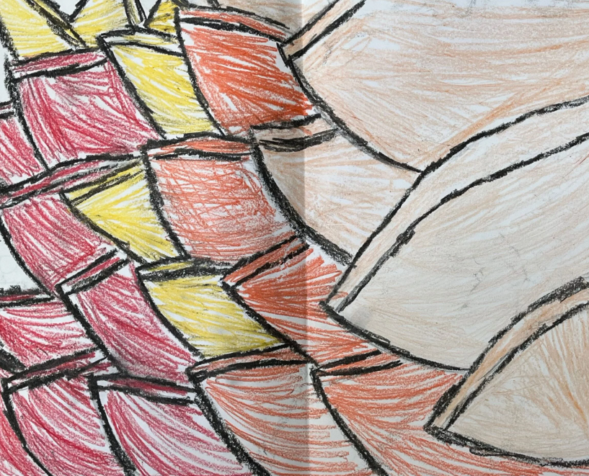
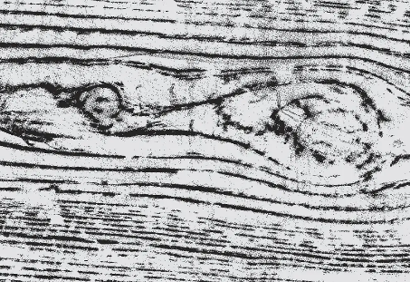
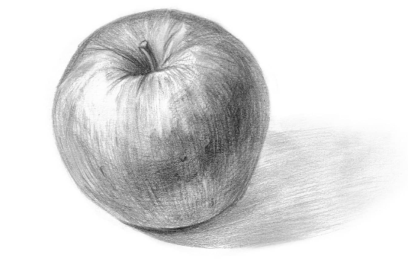
Art: Drawing: Flowers Composition
Key Vocabulary:
Tone | A term that describes the dark and light areas of an object or composition.
Texture | The visual and physical quality of the surface of a piece of art.
Observational Drawing | The act of drawing what you see in real life.
Composition | The arrangement of objects within a piece of art.
Organic and Geometric Shapes | Organic shapes are those that occur in nature. Geometric shapes are those that are defined by clear edges and corners.
Sticky Knowledge Facts:
Identifying the simple shapes in an object help artists to establish the composition and proportion of what they are drawing before adding details There are four rules of shading to help artists make a drawing realistic, which are: shade in one direction; not leave any gaps; work neatly to the edges and create smooth, even tones Changing the surface, medium and technique of a rubbing can change the texture of a drawing When completing an observational drawing, artists first draw the simple shapes of the composition lightly, before adding detail over the top by changing the medium and by adding shading. You can use a viewfinder to select an interesting composition

Slide 2
Identifying the simple shapes in an object help artists to establish the composition and proportion of what they are drawing before adding details.

Slide 3
There are four rules of shading to help artists make a drawing realistic, which are: shade in one direction; not leave any gaps; work neatly to the edges and create smooth, even tones.

Slide 4
Changing the surface, medium and technique of a rubbing can change the texture of a drawing.

Slide 5
When completing an observational drawing, artists first draw the simple shapes of the composition lightly, before adding detail over the top by changing the medium and by adding shading.

Slide 6
You can use a viewfinder to select an interesting composition.

